Slide 1
BÀI 3 – TÌM KIẾM MÙ
THUẬT TOÁN
BREADT-FIRST SEARCH
DEPTH-FIRST SEARCH

Slide 2
Search
We have some actions that can change the state of the world
  Change resulting from an action perfectly predictable
Try to come up with a sequence of actions that will lead us to a goal state
  May want to minimize number of actions
  More generally, may want to minimize total cost of actions
Do not need to execute actions in real life while searching for solution!
  Everything perfectly predictable anyway

Slide 3
A simple example: traveling on a graph
2
C
B
9
2
3
goal state
F
start state
A
E
3
D
4
4

Slide 4
Searching for a solution
2
C
B
9
2
3
goal state
F
start state
A
3
D

Slide 5
Search tree
state = A,
cost = 0
state = B,
cost = 3
state = D,
cost = 3
state = C,
cost = 5
state = F,
cost = 12
goal state!
state = A,
cost = 7
search tree nodes and states are not the same thing!

Slide 6
Full search tree
state = A,
cost = 0
state = B,
cost = 3
state = D,
cost = 3
state = C,
cost = 5
state = F,
cost = 12
state = E,
cost = 7
goal state!
state = A,
cost = 7
state = F,
cost = 11
goal state!
.
state = B,
cost = 10
.
state = D,
cost = 10
.
.
.
.

Slide 7
Changing the goal: want to visit all vertices on the graph
2
C
B
9
2
3
F
A
E
3
D
4
4
need a different definition of a state
“currently at A, also visited B, C already”
large number of states: n*2^{n-1}
could turn these into a graph, but…

Slide 8
Full search tree
state = A, {}
cost = 0
state = B, {A}
cost = 3
state = D, {A}
cost = 3
state = C, {A, B}
cost = 5
state = F, {A, B}
cost = 12
state = E, {A, D}
cost = 7
state = A, {B, C}
cost = 7
state = F, {A, D, E}
cost = 11
state = B, {A, C}
cost = 10
state = D, {A, B, C}
cost = 10
What would happen if the goal were to visit every location twice?
.
.
.
.
.
.

Slide 9
Key concepts in search
Set of states that we can be in
  Including an initial state…
  … and goal states (equivalently, a goal test)
For every state, a set of actions that we can take
  Each action results in a new state
  Typically defined by successor function
    Given a state, produces all states that can be reached from it
Cost function that determines the cost of each action (or path = sequence of actions)
Solution: path from initial state to a goal state
  Optimal solution: solution with minimal cost

Slide 10
8-puzzle
1 |  | 2
4 | 5 | 3
7 | 8 | 6
1 | 2 | 3
4 | 5 | 6
7 | 8
goal state

Slide 11
8-puzzle
1 |  | 2
4 | 5 | 3
7 | 8 | 6
1 | 2
4 | 5 | 3
7 | 8 | 6
 | 1 | 2
4 | 5 | 3
7 | 8 | 6
1 | 5 | 2
4 |  | 3
7 | 8 | 6
.
.
.
.
.
.

Slide 12
Generic search algorithm
Fringe = set of nodes generated but not expanded
  = nodes we know we still have to explore
fringe := {node corresponding to initial state}
loop:
  if fringe empty, declare failure
  choose and remove a node v from fringe
  check if v’s state s is a goal state; if so, declare success
  if not, expand v, insert resulting nodes into fringe
Key question in search: Which of the generated nodes do we expand next?

Slide 13
Uninformed search
Uninformed search: given a state, we only know whether it is a goal state or not
Cannot say one nongoal state looks better than another nongoal state
Can only traverse state space blindly in hope of somehow hitting a goal state at some point
  Also called blind search
  Blind does not imply unsystematic!

Slide 14
Breadth-first search

Slide 15
Properties of breadth-first search
Nodes are expanded in the same order in which they are generated
  Fringe can be maintained as a First-In-First-Out (FIFO) queue
BFS is complete: if a solution exists, one will be found
BFS finds a shallowest solution
  Not necessarily an optimal solution
If every node has b successors (the branching factor), first solution is at depth d, then fringe size will be at least b^{d} at some point
  This much space (and time) required ☹

Slide 16
Depth-first search

Slide 17
Implementing depth-first search
Fringe can be maintained as a Last-In-First-Out (LIFO) queue (aka. a stack)
Also easy to implement recursively:
DFS(node)
  If goal(node) return solution(node);
  For each successor of node
    Return DFS(successor) unless it is failure;
  Return failure;

Slide 18
Properties of depth-first search
Not complete (might cycle through nongoal states)
If solution found, generally not optimal/shallowest
If every node has b successors (the branching factor), and we search to at most depth m, fringe is at most bm
  Much better space requirement ☺
  Actually, generally don’t even need to store all of fringe
Time: still need to look at every node
  b^{m} + b^{m-1} + … + 1 (for b>1, O(b^{m}))
  Inevitable for uninformed search methods…

Slide 19
Combining good properties of BFS and DFS
Limited depth DFS: just like DFS, except never go deeper than some depth d
Iterative deepening DFS:
  Call limited depth DFS with depth 0;
  If unsuccessful, call with depth 1;
  If unsuccessful, call with depth 2;
  Etc.
Complete, finds shallowest solution
Space requirements of DFS
May seem wasteful timewise because replicating effort
  Really not that wasteful because almost all effort at deepest level
  db + (d-1)b² + (d-2)b³ + ... + 1b^{d} is O(b^{d}) for b > 1

Slide 20
Let’s start thinking about cost
BFS finds shallowest solution because always works on shallowest nodes first
Similar idea: always work on the lowest-cost node first (uniform-cost search)
If it finds a solution, it will be an optimal one
Will often pursue lots of short steps first
If optimal cost is C, and cost increases by at least L each step, we can go to depth C/L
Similar memory problems as BFS
  Iterative lengthening DFS does DFS up to increasing costs

Slide 21
Uniform cost search
state = A,
cost = 0
state = B,
cost = 3
state = D,
cost = 3
state = C,
cost = 5
state = F,
cost = 12
state = E,
cost = 7
state = A,
cost = 7
state = F,
cost = 11
goal state!
state = B,
cost = 10
state = D,
cost = 10

Slide 22
Searching backwards from the goal
Sometimes can search backwards from the goal
  Maze puzzles
  Eights puzzle
  Reaching location F
  What about the goal of “having visited all locations”?
Need to be able to compute predecessors instead of successors
What’s the point?

Slide 23
Predecessor branching factor can be smaller than successor branching factor
Stacking blocks:
  only action is to add something to the stack
A
B
C
In hand: A, B, C
In hand: nothing
Start state
Goal state
We’ll see more of this…

Slide 24
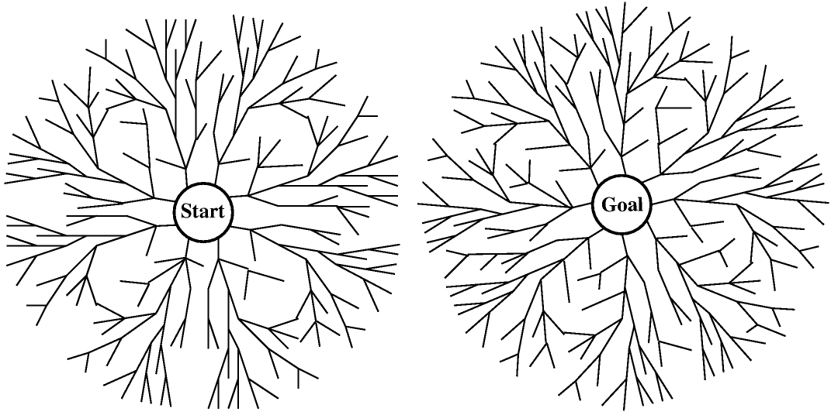
Bidirectional search
Even better: search from both the start and the goal, in parallel!
image from cs-alb-pc3.massey.ac.nz/notes/59302/fig03.17.gif
If the shallowest solution has depth d and branching factor is b on both sides, requires only O(b^{d/2}) nodes to be explored!

Slide 25
Making bidirectional search work
Need to be able to figure out whether the fringes intersect
  Need to keep at least one fringe in memory…
Other than that, can do various kinds of search on either tree, and get the corresponding optimality etc. guarantees
Not possible (feasible) if backwards search not possible (feasible)
  Hard to compute predecessors
  High predecessor branching factor
  Too many goal states

Slide 26
Repeated states
2
C
B
2
3
A
cycles
exponentially large search trees (try it!)
Repeated states can cause incompleteness or enormous runtimes
Can maintain list of previously visited states to avoid this
  If new path to the same state has greater cost, don’t pursue it further
  Leads to time/space tradeoff
“Algorithms that forget their history are doomed to repeat it” [Russell and Norvig]

Slide 27
Informed search
So far, have assumed that no nongoal state looks better than another
Unrealistic
  Even without knowing the road structure, some locations seem closer to the goal than others
  Some states of the 8s puzzle seem closer to the goal than others
Makes sense to expand closer-seeming nodes first

Slide 28
Heuristics
Key notion: heuristic function h(n) gives an estimate of the distance from n to the goal
  h(n)=0 for goal nodes
E.g. straight-line distance for traveling problem
2
C
B
9
2
3
goal state
F
start state
A
E
3
D
4
4
Say: h(A) = 9, h(B) = 8, h(C) = 9, h(D) = 6, h(E) = 3, h(F) = 0
  Typically assume that h is 0 at goal states
We’re adding something new to the problem!
Can use heuristic to decide which nodes to expand first

Slide 29
Greedy best-first search
Greedy best-first search: expand nodes with lowest h values first
state = A,
cost = 0, h = 9
state = B,
cost = 3, h = 8
state = D,
cost = 3, h = 6
state = E,
cost = 7, h = 3
state = F,
cost = 11, h = 0
Rapidly finds the optimal solution!
Does it always?
goal state!

Slide 30
A bad example for greedy
7
B
6
F
goal state
start state
A
E
3
D
4
4
Say: h(A) = 9, h(B) = 5, h(D) = 6, h(E) = 3, h(F) = 0
Problem: greedy evaluates the promise of a node only by how far is left to go, does not take cost incurred already into account

Slide 31
A*
Let g(n) be cost incurred already on path to n
Expand nodes with lowest g(n) + h(n) first
7
B
6
F
goal state
start state
A
E
3
D
4
4
Say: h(A) = 9, h(B) = 5, h(D) = 6, h(E) = 3, h(F) = 0
Note: if h=0 everywhere, then just uniform cost search

Slide 32
A* example
state = A,
g = 0, h = 9
state = B,
g = 3, h = 8
state = D,
g = 3, h = 6
state = E,
g = 7, h = 3
state = F,
g = 11, h = 0
goal state!

Slide 33
Admissibility
A heuristic is admissible if it never overestimates the distance to the goal
  If n is the optimal solution from n’, then g(n) ≥ g(n’) + h(n’)
Straight-line distance is admissible: can’t hope for anything better than a straight road to the goal
Admissible heuristic means that A* is always optimistic

Slide 34
Optimality of A*
If the heuristic is admissible, A* is optimal (in the sense that it will never return a suboptimal solution)
Proof:
  Suppose a suboptimal solution node n with solution value C > C* is about to be expanded (where C* is optimal)
  Let n* be an optimal solution node (perhaps not yet discovered)
  There must be some node n’ that is currently in the fringe and on the path to n*
  We have g(n) = C > C* = g(n*) ≥ g(n’) + h(n’)
  But then, n’ should be expanded first (contradiction)

Slide 35
A* is not complete (in contrived examples)
B
goal state
A
C
D
E
…
F
start state
infinitely many nodes on a straight path to the goal that doesn’t actually reach the goal
No optimal search algorithm can succeed on this example (have to keep looking down the path in hope of suddenly finding a solution)
Also true for uniform cost search (special case of A*)

Slide 36
A* is optimally efficient
A* is optimally efficient in the sense that any other optimal algorithm must expand at least the nodes A* expands
Proof:
  Besides solution, A* expands exactly the nodes with g(n)+h(n) < C*
    Assuming it does not expand non-solution nodes with g(n)+h(n) = C*
  Any other optimal algorithm must expand at least these nodes (since there may be a better solution there)
Note: This argument assumes that the other algorithm uses the same heuristic h

Slide 37
A* and repeated states
Suppose we try to avoid repeated states
Ideally, the second (or third, …) time that we reach a state the cost is at least as high as the first time
  Otherwise, have to update everything that came after
This is guaranteed if the heuristic is consistent: if one step takes us from n to n’, then h(n) ≤ h(n’) + cost of step from n to n’
  Similar to triangle inequality

Slide 38
Proof
Suppose n and n’ correspond to same state, n’ is cheaper to reach, but n is expanded first
n’ cannot have been in the fringe when n was expanded because g(n’) < g(n), so
  g(n’) + h(n’) < g(n) + h(n)
So n’ is generated (eventually) from some other node n’’ currently in the fringe, after n is expanded
  g(n) + h(n) ≤ g(n’’) + h(n’’)
Combining these, we get
  g(n’) + h(n’) < g(n’’) + h(n’’), or equivalently
  h(n’’) > h(n’) + cost of steps from n’’ to n’
    Violates consistency

Slide 39
Iterative Deepening A*
One big drawback of A* is the space requirement: similar problems as uniform cost search, BFS
Limited-cost depth-first A*: some cost cutoff c, any node with g(n)+h(n) > c is not expanded, otherwise DFS
IDA* gradually increases the cutoff of this
Can require lots of iterations
  Trading off space and time…
  RBFS algorithm reduces wasted effort of IDA*, still linear space requirement
  SMA* proceeds as A* until memory is full, then starts doing other things

Slide 40
More about heuristics
1 |  | 2
4 | 5 | 3
7 | 8 | 6
One heuristic: number of misplaced tiles
Another heuristic: sum of Manhattan distances of tiles to their goal location
  Manhattan distance = number of moves required if no other tiles are in the way
Admissible? Which is better?
Admissible heuristic h₁ dominates admissible heuristic h₂ if h₁(n) ≥ h₂(n) for all n
  Will result in fewer node expansions
“Best” heuristic of all: solve the remainder of the problem optimally with search
  Need to worry about computation time of heuristics…

Slide 41
Designing heuristics
One strategy for designing heuristics: relax the problem (make it easier)
“Number of misplaced tiles” heuristic corresponds to relaxed problem where tiles can jump to any location, even if something else is already there
“Sum of Manhattan distances” corresponds to relaxed problem where multiple tiles can occupy the same spot
Another relaxed problem: only move 1,2,3,4 into correct locations
The ideal relaxed problem is
  easy to solve,
  not much cheaper to solve than original problem
Some programs can successfully automatically create heuristics

Slide 42
Macro-operators
Perhaps a more human way of thinking about search in the eights puzzle:
1 | 2 | 3
8 |  | 4
7 | 6 | 5
8 | 2 | 1
7 |  | 3
6 | 5 | 4
sequence of operations = macro-operation
We swapped two adjacent tiles, and rotated everything
Can get all tiles in the right order this way
  Order might still be rotated in one of eight different ways; could solve these separately
Optimality?
Can AI think about the problem this way? Should it?

